Slide 1



Internship Project 2 at Mentorness
Telco Customer Churn Prediction Analysis
By Siddhant Ghosh

Slide 2


CONTENT
01
UNDERSTANDING CUSTOMER CHURN
02
DATA ANALYSIS AND MODEL BUILDING
03
STRATEGIES FOR CUSTOMER RETENTION

Slide 3
CONTENT
01
UNDERSTANDING CUSTOMER CHURN
02
DATA ANALYSIS AND MODEL BUILDING
03
STRATEGIES FOR CUSTOMER RETENTION

Slide 4





Understanding Customer Churn
Common Indicators
What is Churn?
Impact
The churn rate, also known as the attrition rate, quantifies the number of individuals or items departing from a collective group within a specific timeframe.
Churn can have significant financial implications for a business, including loss of revenue, increased marketing costs, and damage to the brand's reputation.
Identifying signs of potential churn, such as decreased usage, missed payments, or customer complaints, is crucial for proactive intervention.

Slide 5

Importance of Churn Prediction
Proactive Measures
Predicting customer churn enables companies to take proactive measures to retain customers before they decide to leave.
Resource Allocation
It helps in optimizing resource allocation by focusing retention efforts on customers with a higher likelihood of churning.
Enhanced Customer Experience
Anticipating churn allows for personalized interventions, leading to an enhanced overall customer experience.

Slide 6
CONTENT
01
UNDERSTANDING CUSTOMER CHURN
02
DATA ANALYSIS AND MODEL BUILDING
03
STRATEGIES FOR CUSTOMER RETENTION

Slide 7


Case Study: Telecom Churn Analysis
1
Analyzing churn patterns in the telecom industry, including factors such as contract length, data usage, and customer support interactions.
2
The dataset has 7043 rows and 21 columns. There are only 11 missing values in only one feature column.
3
The dataset has class imbalance in the target column.

Slide 8
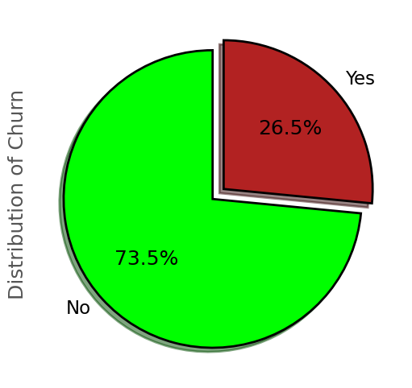
Class Imbalance
The target column named as ‘Churn’ (on the basis of this column, we have to predict the whether a customer will churn or not) has ‘moderate’ level of class imbalance.

Slide 9
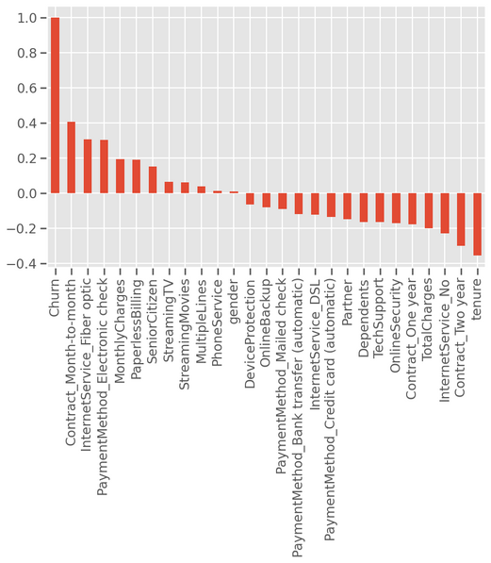
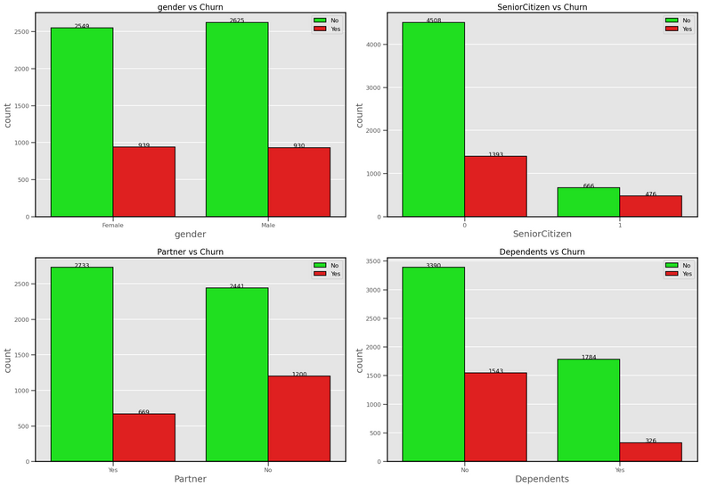
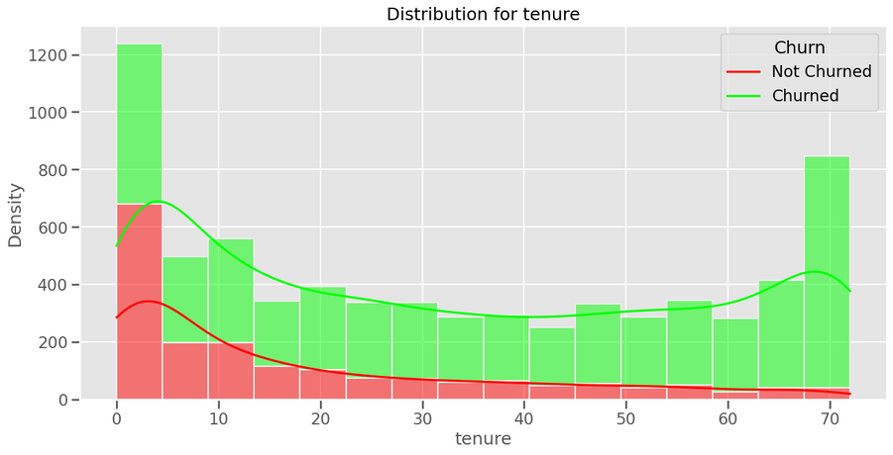
Data Preprocessing & EDA
Replaced occurrences of 'No internet service' and 'No phone service' with 'No' as they are functionally equivalent.
Divided the feature columns into 3 different categories based on their functionalities.
Plotted features within each category to gain insights.
Plotted the distribution of numerical features.
Checked for outliers; fortunately, there were none.
Removed missing values from the dataset.
Mapped categorical columns into numerical values for model training purposes.
Checked the correlation between columns and the churn feature.

Slide 10
Gained Insights from EDA:
Gender and partner distribution are balanced.
Churn slightly higher in females, but negligible.
Younger, single customers with no dependents churn more.
Non-senior citizens without partners or dependents likely to churn.
Phone service absence implies no multiple lines.
Fiber optic internet customers show higher churn.
Additional services like security and support reduce churn.
Short contracts and paperless billing correlate with higher churn.

Slide 11
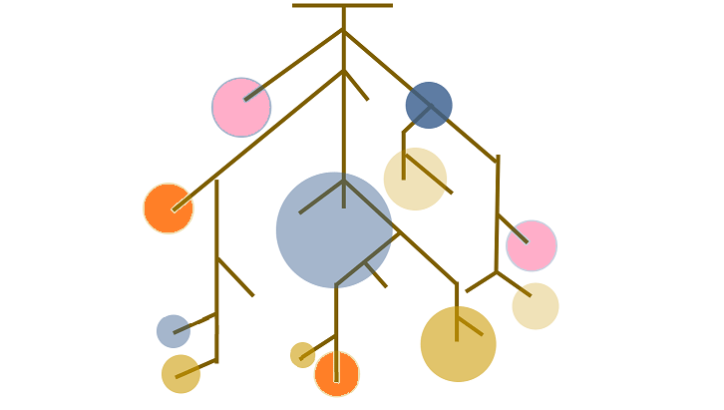
Model Training
Applied SMOTEENN oversampling technique to address data imbalance.
Employed various machine learning algorithms.
Focused on recall score and F1 score for evaluation.
Plotted ROC curves and confusion matrices for insight.
Conducted hyperparameter tuning for optimization.
Selected Random Forest Classifier (RFC) as the primary model.

Slide 12
CONTENT
01
UNDERSTANDING CUSTOMER CHURN
02
DATA ANALYSIS AND MODEL BUILDING
03
STRATEGIES FOR CUSTOMER RETENTION

Slide 13
Strategies for maximizing Customer retention
Tailor services and pricing for SeniorCitizen, partner, and single customers.
Provide top-tier service quality for SeniorCitizens.
Offer services below $65 for customers with a partner or living alone.
Focus on essential support services for new customers in the first six months.
Promote MultipleLines and Fiber Optic cables after establishing support.
Manage MonthlyCharges starting point, often exceeding $75+ for these services.
Create bundled options to maintain average MonthlyCharges of $100-120.
Prioritize affordable pricing and reduced churn tenure for streaming services.
Encourage convenient PaymentMethods.
Phase out Electronic check payments.
Justify PaperlessBilling cost with high-quality service.

Slide 14

Thank You!
FOLLOW MENTORNESS

